Slide 1
Lecture 08
CSE 3213
Computer graphics
Drawing Elementary Figures

Slide 2
Bresenham ’s Line Drawing Algorithm
The simple DDA has the disadvantages of using two operations that are expensive in computational time: floating point addition and the round function.
Several good line drawing algorithms avoid these problems by using only integer arithmetic such as Bresenham’s line drawing algorithm.
The Bresenham’s line drawing algorithm is another incremental scan conversion algorithm.
The big advantage of this algorithm is that it uses only integer calculations.

Slide 3
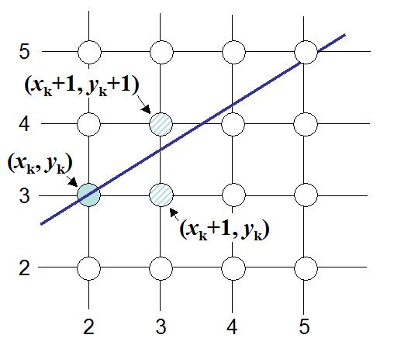
Bresenham ’s Line Drawing Algorithm
The main Idea of the Bresenham’s line drawing algorithm: Move across the x-axis in unit intervals and at each step choose between two different y coordinates.
For example
from position (2,3) we have to choose between (3,3) and (3,4), we would like the point that is closer to the original line.

Slide 4
Bresenham ’s Line Drawing Algorithm
Deriving The Bresenham Line Algorithm
To illustrate Bresenham’s approach, we first consider the scan conversion process for lines with positive slope less than 1 (m<1).
Pixel positions along a line path are determined by sampling at unit x intervals. Starting from the left endpoint (x₀, y₀) of a given line, we step to each successive column (x position) and demonstrate the k^{th} step in this process.
Assuming we have determined that the pixel at (x_{k}, y_{k}) is to be displayed, we next need to decide which pixel to plot in column x_{k}+1. Our choices are the pixels at positions (x_{k}+1, y_{k}) and (x_{k}+1, y_{k}+1).

Slide 5
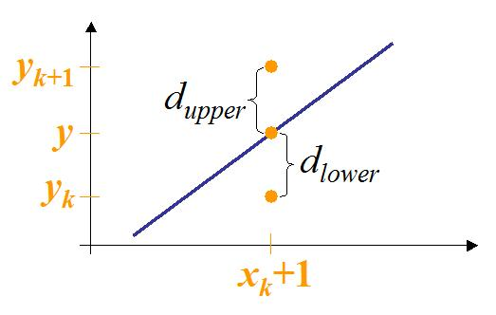
Bresenham ’s Line Drawing Algorithm
At sampling position x_{k}+1, the vertical separations from the mathematical line path are labelled as d_{upper} and d_{lower} as shown in the following figure:
The y coordinate on the mathematical line at pixel column x_{k}+1 is calculated as: y = m(x_{k}+1) + b

Slide 6
Bresenham ’s Line Drawing Algorithm
So, d_{upper} and d_{lower} are given as follows:
d_{lower} = y – y_{k}= m(x_{k} + 1) + b – y_{k}
d_{upper} = y_{k} + 1 – y = y_{k}+ 1– m(x_{k} + 1) – b
The difference between these two separations is
d_{lower} – d_{upper} = 2m(x_{k} + 1)–2y_{k} + 2b – 1

Slide 7
Bresenham ’s Line Drawing Algorithm
d_{lower} – d_{upper} = 2m(x_{k} + 1)–2y_{k} + 2b – 1
Let’s substitute m with ∆y/∆x where ∆x and ∆y are the differences between the end-points:
d_{lower} – d_{upper} = 2(∆y/∆x)(x_{k} + 1) – 2y_{k} + 2b – 1
= (1/∆x)[ 2∆y x_{k}+ 2∆y – 2∆x y_{k} + 2∆x b – ∆x]
= (1/∆x)[ 2∆y x_{k} – 2∆x y_{k} + 2∆x b – ∆x + 2∆y]
= (1/∆x)[ 2∆y x_{k} – 2∆x y_{k} + c]
Where c = 2∆x b – ∆x + 2∆y
∆x (d_{lower} – d_{upper}) = 2∆y x_{k} – 2∆x y_{k} + c

Slide 8
Bresenham ’s Line Drawing Algorithm
∆x (d_{lower} – d_{upper}) = 2∆y x_{k} – 2∆x y_{k} + c
This equation is used as a simple decision about which pixel is closer to the mathematical line.
So, a decision parameter p_{k} for the k^{th} step along a line is given by:
p_{k} = ∆x (d_{lower} – d_{upper}) = 2∆y x_{k} – 2∆x y_{k} + c
The sign of the decision parameter p_{k} is the same the sign of d_{lower}–d_{upper},
if the pixel at y_{k} is closer to the line path than the pixel at y_{k}+1 (that is d_{lower}<d_{upper}), then decision parameter p_{k} is negative. In this case we plot the lower pixel, otherwise we plot the upper pixel.

Slide 9
Bresenham ’s Line Drawing Algorithm
Coordinate changes along the line occur in unit steps in either the x or y directions. Therefore, we can obtain the values of successive decision parameters using incremental integer calculations.
At step k+1 the decision parameter is given as:
p_{k+1} = 2∆y x_{k+1} – 2∆x y_{k+1} + c
Subtracting p_{k} from this we get:
p_{k+1} – p_{k} = 2∆y( x_{k+1}– x_{k} ) – 2∆x( y_{k+1} – y_{k} )
But, x_{k+1} is the same as x_{k}+1 so that
p_{k+1} = p_{k} + 2∆y – 2∆x( y_{k+1}– y_{k} )
Where y_{k+1} – y_{k} is either 0 or 1, depending on the sign of parameter p_{k}.

Slide 10
Bresenham ’s Line Drawing Algorithm
The recursive calculation of decision parameters is performed at each integer x position, starting at the left coordinate endpoint of the line.
The first decision parameter p_{k} is evaluated at the starting pixel position (x_{k}, y_{k}) and with m evaluatedas (∆y/∆x):
  p_{k} = 2∆y x_{k} – 2∆x y_{k} + 2∆x b – ∆x + 2∆y
  p_{k} = 2∆y x_{k} + 2∆y – 2∆x y_{k} + ∆x( 2b – 1)
  p_{k} = 2∆y x_{k} + 2∆y – 2∆x y_{k} + ∆x( 2(y_{k} – m x_{k}) –1)
  p_{k} = 2∆y x_{k} + 2∆y – 2∆x y_{k} + 2∆xy_{k} – ∆x. ∆y/∆x . x_{k} – ∆x
  p_{k} = 2∆y x_{k} + 2∆y – 2∆x y_{k} + 2∆xy_{k} – 2.∆x. ∆y/∆x . x_{k} – ∆x
  p_{o} = 2∆y– ∆x
The following steps summarize Bresenham’s Line Drawing Algorithm for a line with positive slope less than 1 (|m|<1)

Slide 11
Bresenham ’s Line Drawing Algorithm
p_{k+1} = p_{k} + 2∆y – 2∆x( y_{k+1}– y_{k} )
Input the two line end-points, storing the left end-point in (x₀,y₀)
Plot the point (x₀, y₀)
Calculate the constants Δx, Δy, 2Δy, and (2Δy - 2Δx) and get the first value for the decision parameter as:
P₀ = 2∆y – ∆x
At each x_{k} along the line, starting at k=0, perform the following test:
If p_{k} < 0, the next point to plot is (x_{k}+1, y_{k}) and
p_{k+1} = p_{k} + 2∆y
Otherwise, the next point to plot is (x_{k}+1, y_{k}+1) and
p_{k+1} = p_{k} + 2∆y – 2∆x
Repeat step 4 (Δx ) times

Slide 12
End

